Slide 1
AI-Enhanced Factor Analysis for Predicting S&P 500 Stock Dynamics
Sixun Chen, JiaJun Gu, Xingtong Lin, Yuting Lu, Zichen Yang

Slide 2
Introduction
Forecasting Stock Returns
A challenging task due to the unpredictable nature of financial markets
Modern machine learning methods, like Ridge regression, random forests, and gradient boosting, handle large and nonlinear dataset effectively
Research Objective
Explore how machine learning models improve stock return predictions
Focus of the Study
Analyze the S&P 500 index, representing leading U.S. companies
Examine the impact of financial and technical indicators on stock prices and returns
Notes:
This study examines the S&P 500 index, a benchmark representing the performance of leading U.S. companies, to analyze how key financial and technical indicators impact stock prices and returns. By calculating a range of financial factors such as momentum, volatility, market capitalization, and illiquidity measures, the research establishes a comprehensive dataset for analysis. Machine learning models are then applied to uncover nonlinear relationships and improve prediction capabilities.

Slide 3
Data
Data Source: CRSP Database
CRSP MSP500 List
CRSP MSF with Monthly Frequency
CRSP MSENAMES
Study Period: January 1, 2019, to Present
Data Preprocessing
Data Merging to Align S&P 500 list data with stock price and trading volume data using permno identifiers to ensures stock-specific information aligns with company attributes
Date Range Filtering for data to match the start and end dates of each company's S&P 500 inclusion and ensure that data is within valid periods for each stock
Missing Data Handling: Fill missing values using forward-fill within each stock group, and replace unresolved missing values with zero, and handle extreme values by replacing infinite values with NaN and applying forward-fill technique

Slide 4
Factor Choice
Size Factors
Market_Cap: Market capitalization (absolute price × outstanding shares)
Log_Market_Cap: Log-transformed market capitalization
Momentum Factors
Momentum: 12-month momentum (percentage change in price over 4 periods)
Momentum_Change: Change in momentum compared to the previous period
Momentum_MA: 10-period moving average of momentum
Short_Momentum: Percentage change in price over 20 periods
Long_Momentum: Percentage change in price over 50 periods
Multi_Period_Momentum: Interaction between short and long momentum
Volatility Factors
Volatility_Slope: Change in rolling volatility over time
Rolling_Volatility: 20-period rolling standard deviation of returns
Volatility_Dynamics: Interaction between rolling volatility and its slope
Volatility_Adjusted_Return: Price-based return divided by rolling volatility

Slide 5
Factor Choice
Liquidity Factors
Amihud_Illiquidity: Price-to-volume ratio
Turnover_Ratio: Trading volume divided by outstanding shares
Liquidity_Stress: Turnover ratio scaled by the magnitude of price-based returns and market capitalization
Price-Based Factors
Price_Based_Factors: Simple percentage change in price
High_Low_Spread: Difference between current price and the minimum price for each stock
Normalized_High_Low: High-low spread normalized by price
Technical Indicators
RSI: Relative Strength Index (14-period)
Price_MA_20: 20-period moving average of price
Price_MA_50: 50-period moving average of price
Mean_Reversion: Deviation of price from the 50-period moving average, scaled by rolling volatility

Slide 6
Factor Choice
Interaction Factors
Momentum_vs_MarketCap: Interaction between momentum and log-transformed market capitalization
Volatility_vs_Turnover: Interaction between rolling volatility and turnover ratio
Trend_Strength: Interaction between momentum deviation (from 20-period moving average) and RSI
Risk_Adjusted_Momentum: Momentum scaled by volatility-turnover interaction and rolling volatility
Abnormal_Behavior: Combined effect of momentum, high-low spread, RSI, and illiquidity
Derived Factors
MarketCap_Adjusted_Momentum: Momentum scaled by market capitalization
Momentum_MA_Deviation: Deviation of momentum from its 20-period moving average.
Momentum_RSI: Interaction between momentum and RSI

Slide 7
Factor Choice Behind Rationale
All Factors represent key aspects of market dynamics, including size, momentum, volatility, liquidity, and technical patterns
Size Factors
Market_Cap and Log_Market_Cap: Capture firm scale and significance, which are crucial for understanding risk and return variations across companies
Momentum Factors
Momentum_MA, Short_Momentum, Long_Momentum, Multi_Period_Momentum, and Momentum_MA_Deviation: Identify price trends and turning points, leveraging known anomalies in asset pricing
Trend_Strength: Highlights momentum deviations relative to RSI, capturing shifts in market sentiment
Liquidity Factors
Amihud_Illiquidity and Liquidity_Stress: Measure how trading activity impacts prices and identify illiquid periods, critical for understanding market dynamics
Turnover_Ratio: Assesses trading volume relative to outstanding shares, reflecting investor activity

Slide 8
Factor Choice Behind Rationale
Volatility Factors:
Rolling_Volatility and Volatility_Slope: Offer insights into price stability and risk over time
Volatility_Dynamics: Captures changing risk levels by combining volatility and its slope
Price-Based Factors
High_Low_Spread and Smoothed_Return: Provide insights into price fluctuations and overall returns, enhancing trend detection
Mean_Reversion: Reflects the tendency of prices to revert to averages, useful for identifying overvalued or undervalued conditions
Technical Indicators
RSI: Identifies overbought or oversold conditions, highlighting potential price reversals
Price_MA_20 and Price_MA_50: Track short and long-term trends, offering context for price movements
Interaction Terms
Volatility_vs_Turnover and Volatility_Turnover: Combine risk and liquidity measures to uncover complex market behaviors
Momentum_Liquidity: Links momentum with trading activity, emphasizing periods of significant price moves

Slide 9
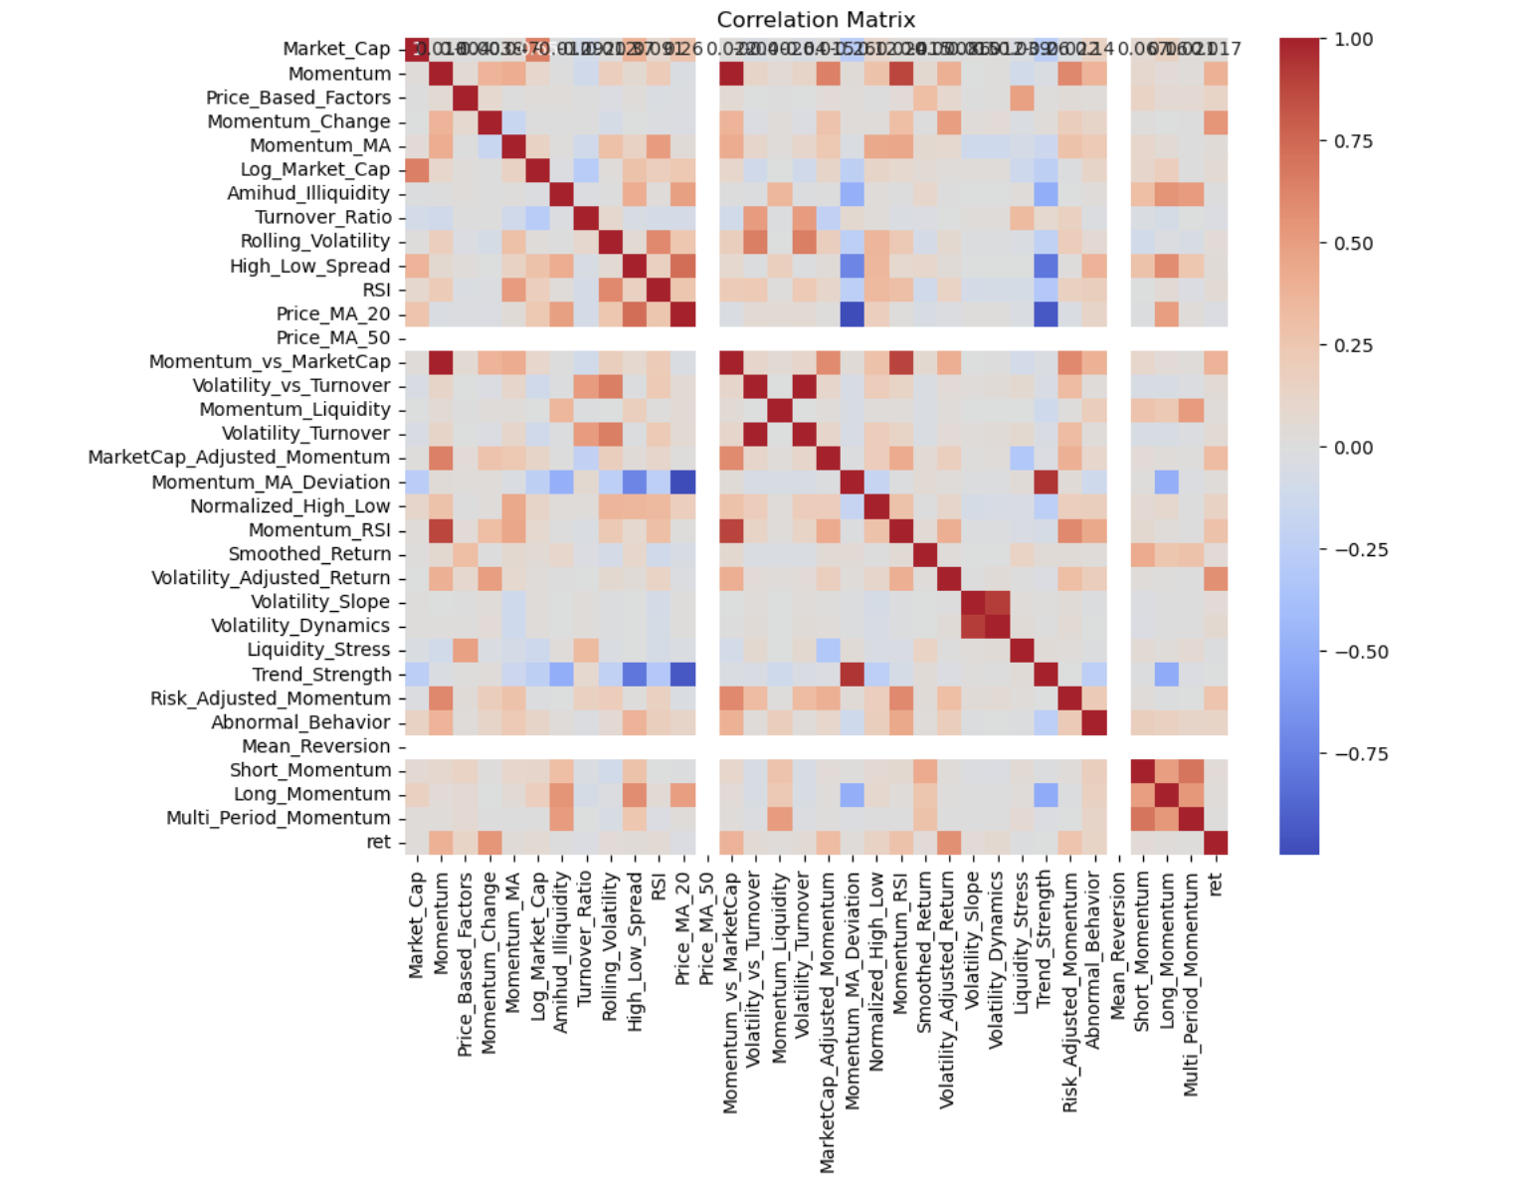
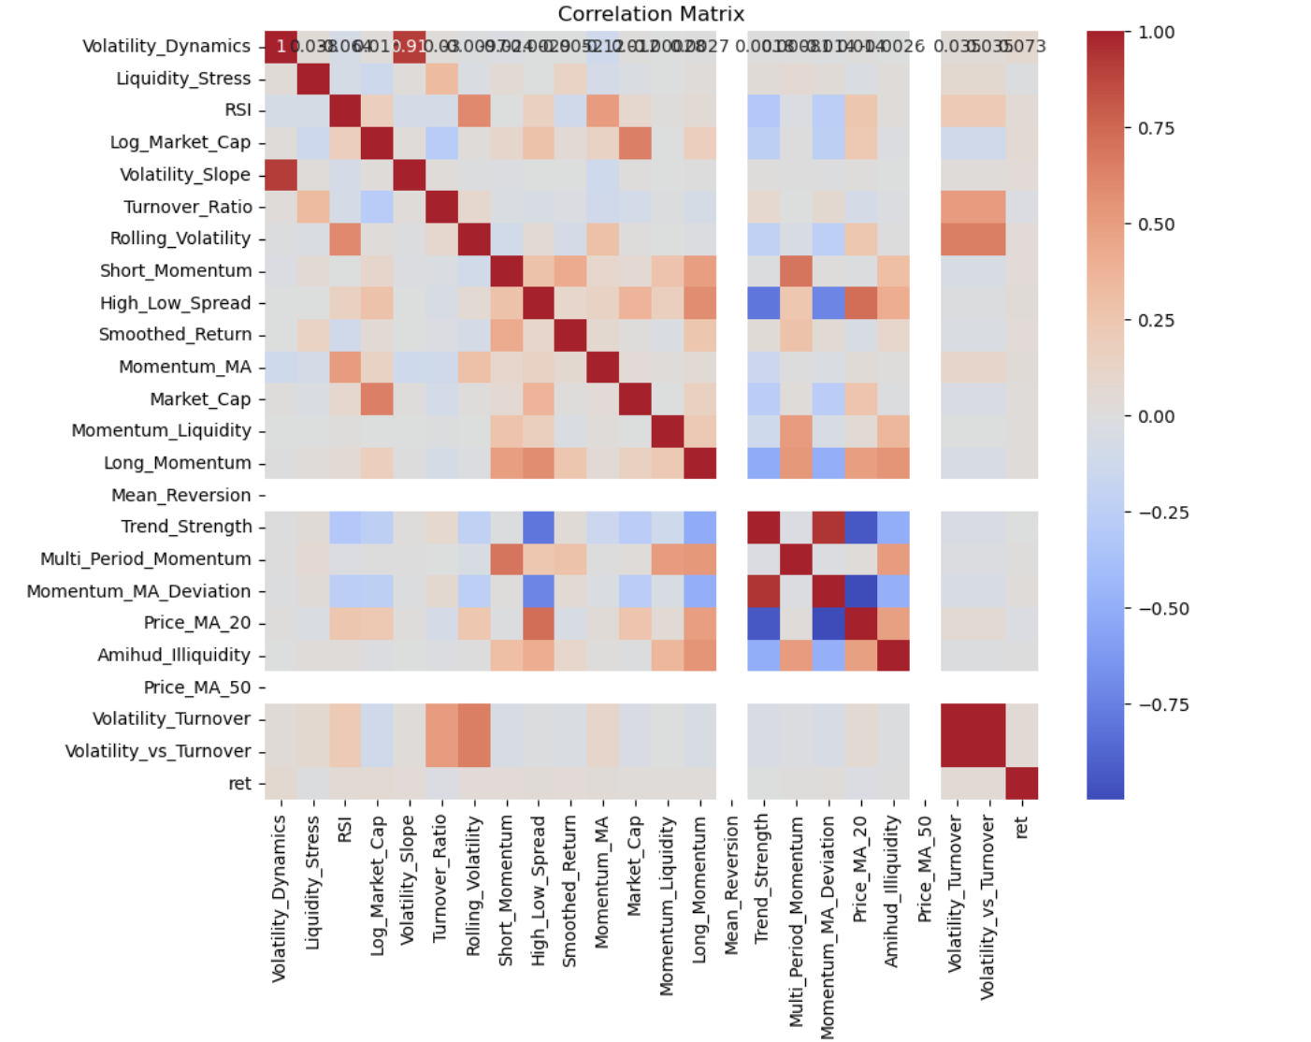
First Layer of Filtering: Factor Choice Behind Rationale
Setting a threshold for correlation with target variable of return with lower than 0.1
Benefits: Reduce Noise in the Model, Enhance Model Interpretability, Prevent Overfitting，Improve Computational Efficiency，Align with Feature Selection Best Practices
Notes:
indicate a weak correlation between x and y variable

Slide 10
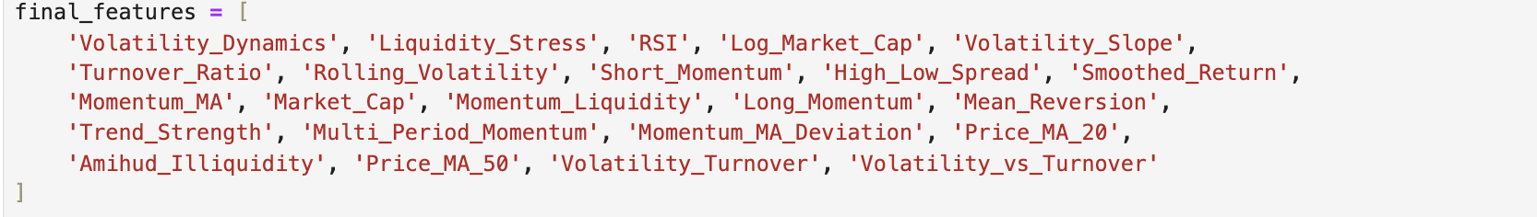
First Layer of Filtering: Factor Choice Behind Rationale
Setting a threshold for correlation with target variable of return with lower than 0.1
Benefits: Reduce Noise in the Model, Enhance Model Interpretability, Prevent Overfitting，Improve Computational Efficiency，Align with Feature Selection Best Practices

Slide 11
Second Layer: Pairwise Correlation Assessment
For any pair of highly correlated factors exceeding the threshold, retained only the factor with the stronger correlation to returns.
This way is to prevent the overemphasis on specific one underlying area in model training.

Slide 12
Best combination of 10 factors after filtering and rating
'Volatility_Dynamics'
'Liquidity_Stress'
'RSI'
'Short_Momentum'
'Long_Momentum'
'High_Low_Spread'
'Smoothed_Return'
'Momentum_Liquidity'
'Amihud_Illiquidity'
'Price_MA_50'

Slide 13


Models
Model | Handles Nonlinearity | Overfitting Control | Interpretability | Computational Cost
Linear Regression | ✗ | ✗ | ✓ | Low
Ridge Regression | ✗ | ✓ | ✓ | Low
Random Forest | ✓ | ✓ | Partial | Moderate
Gradient Boosting | ✓ | ✓ | ✗ | High
Notes:
13

Slide 14
Models
Linear Regression
Provides a simple and interpretable baseline for linear relationships.
Serves as a benchmark for evaluating advanced models.
Computationally efficient for smaller datasets.
Ridge Regression
Addresses multicollinearity with regularization.
Improves generalization and prevents overfitting.
Suitable for datasets with many features.
Random Forest
Captures complex, non-linear relationships.
Highlights key features with feature importance analysis.
Robust against noisy and volatile data.
Gradient Boosting
Excels at modeling complex, non-linear patterns and interactions.
Offers superior predictive accuracy through iterative learning.
Scalable for large datasets with optimized implementations.
Notes:
14

Slide 15
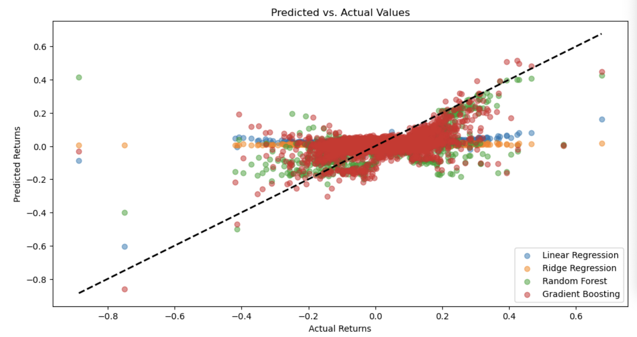
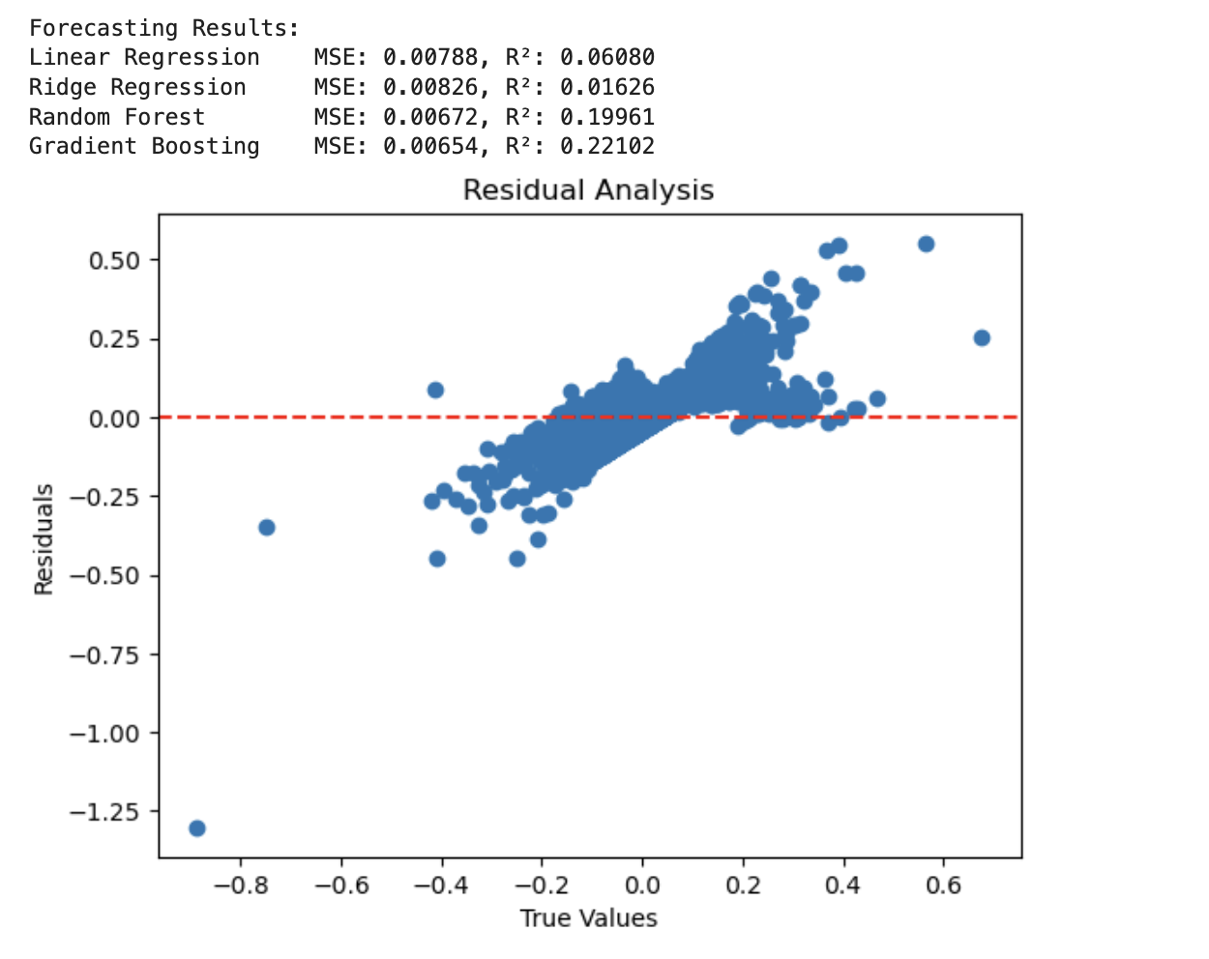
Results and Performance
Scatter Plot Analysis:
The scatter plot compares predicted returns (y-axis) against actual returns (x-axis).
Ideally, the points should align with the dashed diagonal line, representing perfect predictions.
Among the models, Gradient Boosting shows the tightest clustering around the line, indicating the highest prediction accuracy.
Performance Metrics:
Mean Squared Error (MSE): Measures the average squared difference between predicted and actual values. Lower values indicate better performance.
R-Squared: Indicates how much variance in the data is explained by the model. Higher values signify better explanatory power.
Notes:
15

Slide 16
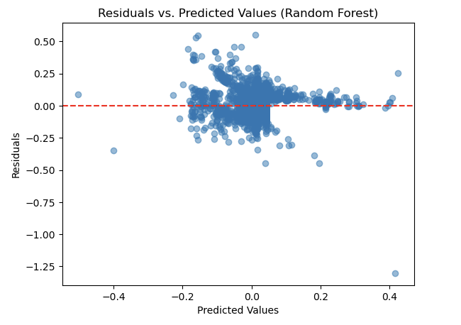
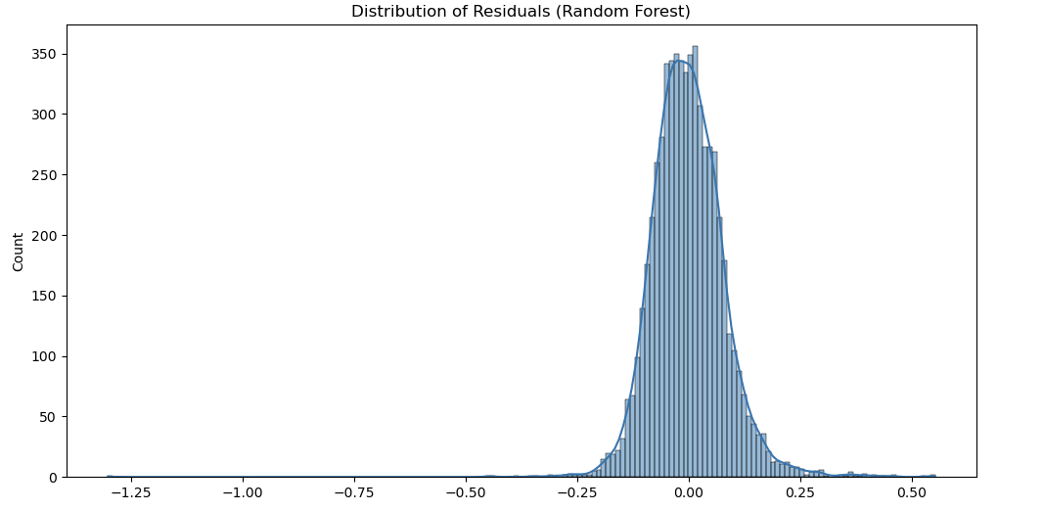
Residual Analysis for Random Forest Model
Clustering of Residuals:
Most residuals are clustered close to the red dashed line (residual = 0)
Outliers and Extreme Values:
A few residuals deviate significantly from the red line.
16 | Presentation Title Presentation Title
Notes:
16

Slide 17
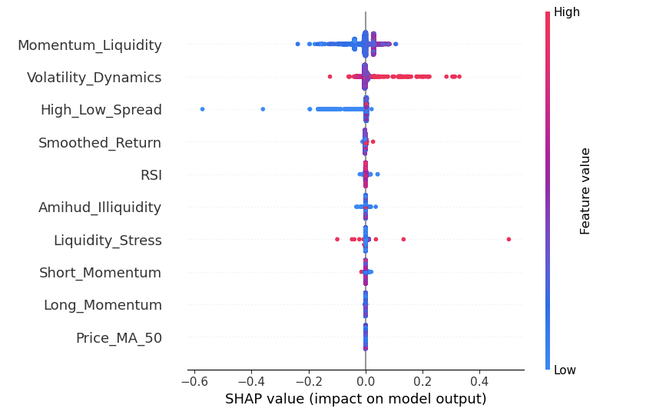
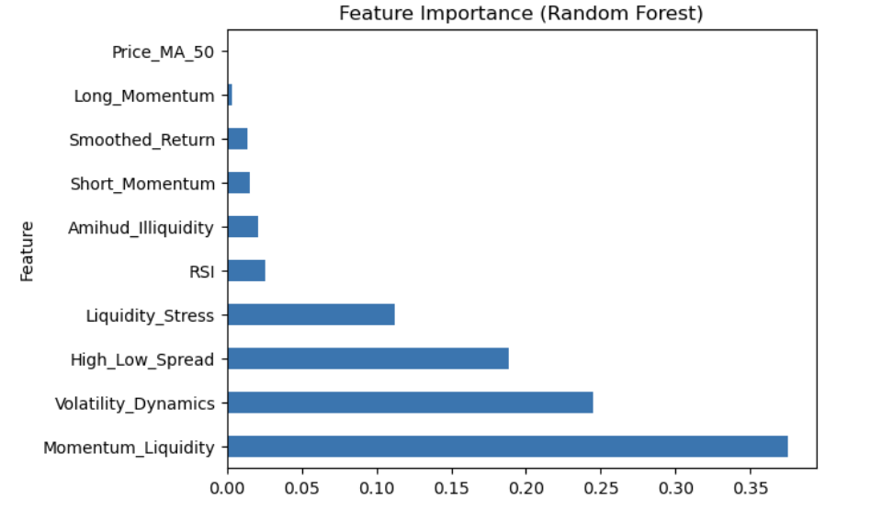
Feature Importance Analysis for Random Forest Model
Feature Importance:
Momentum_Liquidity: The most influential feature, with a wide range of SHAP values, significantly pushing predictions in both positive and negative directions.
Volatility_Dynamics: Plays a crucial role, with higher values (red) typically increasing prediction outputs.
High_Low_Spread: Shows mixed predictive power, contributing positively and negatively depending on the sample's feature value.
Notes:
17

Slide 18
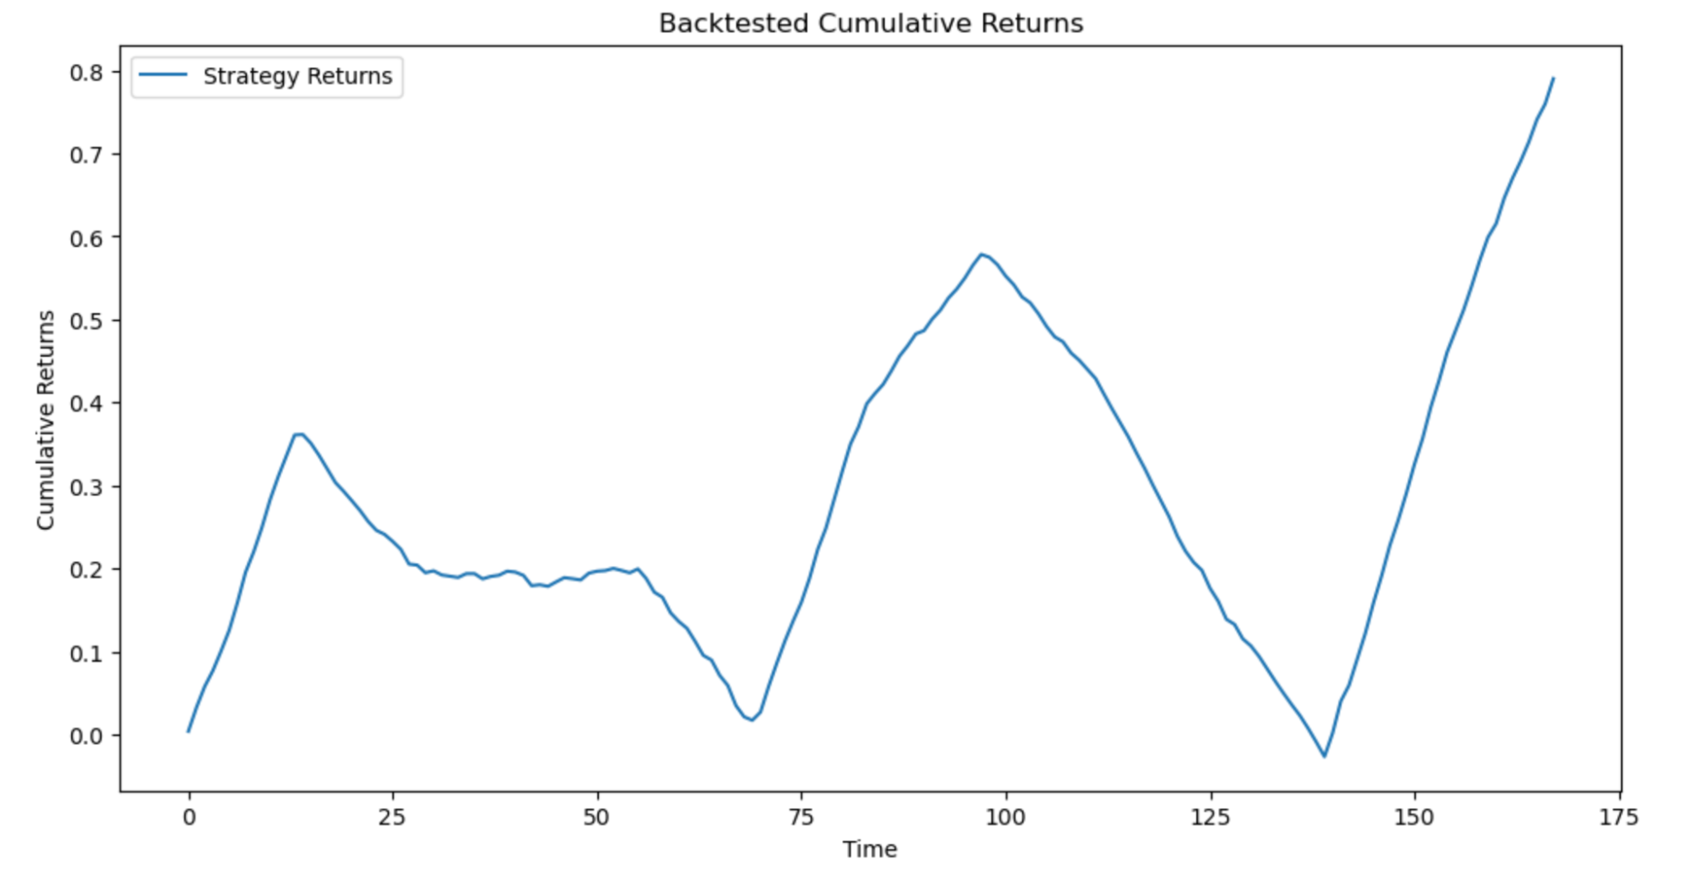
Backtest: Cumulative Return Performance
Methodology:
Training Set: 80% percent of the time before
Rolling Window: 36, Assuming Three years
Gradient Boosting Regressor to forecast the stock return since it has a highest R squared level
Ranking by forecasted stock return and select top 100 stocks for composing the portfolio and equally weighted invested
Strengths:
The strategy can identify profitable investment opportunities during specific periods, as seen in the upward trends in cumulative returns
Machine learning models like Gradient Boosting can capture complex relationships between features and returns, which might explain the recovery towards the end
Weaknesses:
The performance is inconsistent, with periods of sharp declines, which could be due to overfitting, insufficient feature engineering, or lack of adaptability to market conditions
The low Sharpe Ratio suggests that the returns are not sufficiently high to justify the risk
Notes:
Strong Momentum: The strategy experiences rapid surges, particularly in the first 20 periods and towards the end.
Drawdown Sensitivity: The sharp declines indicate that the strategy may be sensitive to market conditions or factor signals, highlighting potential risks during volatile periods.
Recovery Potential: The ability to recover after drawdowns and end with a high cumulative return suggests that the strategy is capable of capturing favorable market movements effectively.
Overall, the strategy demonstrates potential for generating returns but comes with high volatility and significant drawdowns

Slide 19
Future work
Macroeconomic Indicators:
Integrate macroeconomic data such as interest rates, inflation, and GDP growth to understand their impact on portfolio performance.
ESG Factors: Explore the impact of Environmental, Social, and Governance (ESG) metrics on portfolio returns and risk.
Portfolio Optimization Enhancements:
Dynamic Rebalancing Strategies: Develop adaptive rebalancing strategies that respond to changing market conditions in real-time.
Risk-Parity Approaches: Incorporate risk-parity techniques to balance risk contributions across assets or factors.
Transaction Cost Analysis: Account for transaction costs and market impact when implementing portfolio strategies to evaluate real-world performance.

Slide 20
Summary
This report investigates the performance and predictive capabilities of a portfolio constructed using advanced financial factors and machine learning techniques. The primary objective is to understand the drivers behind portfolio outperformance and provide insights for future investment strategies

Slide 21
Reference
Tian Song, Forecasting Stock Returns Using Random Forests and Gradient Boosting
Alberto G, Predicting Stock Market Returns with Machine Learning
Prachi Pathak, Stock Market Prediction Using Machine Learning

Slide 22
Thank You for Listening!

